Slide 1
Programming Principles and Techniques
FUNCTIONS
Notes:
1-13

Slide 2
Learning Outcomes
By the end of this session, you should be able to:
Utilise functions with the correct technique;
Categories two types of variables, local and reference as well as their scope; and
Explain how recursion function works.
Notes:
1-13

Slide 3
What is Function?
Functions can be seen as a small program code that would do a specific task.
Instead of executing the same code for the entire program, you can use a function to execute that specific task, by calling it.
This will reduce repetition of codes in a program.
Pre-defined functions: printf() and scanf()
You can define your own functions.
Notes:
1-13

Slide 4
Component of Function
There are 3 components in function:
  Function call
    This component will call a function and transfer the control to the function.
  Function definition
    This component will execute any statements within the function when it is called by the function call.
  Function prototype
    This component contains information about called function.
Notes:
1-13

Slide 5
Example of Function
#include <stdio.h>
calc();
int main()
{
calc();
}
calc()
{
}
3. Function prototype – contains information about function definition
1. Function call – calling a function named calc()
2. Function definition – called function named, will execute the task
And after finish, the control will be returned back to the calling function
Notes:
1-13

Slide 6
Function Manipulation
There are four ways to call and manipulate functions:
  Calling function without parameter, and without returned value;
  Calling function with parameter, and without returned value;
  Calling function without parameter, and with returned value; and
  Calling function with parameter, and with returned value.
<number> - 13
Notes:
1-13

Slide 7
Calling without parameter,
without returned value
#include <stdio.h>
void sum();
int main()
{
sum();
return 0;
}
void sum()
{
printf("Sum %d + %d = %d\n", 2,3,2+3);
}
Notes:
1-13

Slide 8
Calling without parameter,
with returned value
#include <stdio.h>
int sum();
int main()
{
int total;
total = sum();
printf("Returned value: %d\n", total);
return 0;
}
int sum()
{
int addition;
addition = 2+3;
return addition;
}
Notes:
1-13

Slide 9
Calling with parameter,
without returned value
#include <stdio.h>
void sum(int, int);
int main()
{
sum(2,3);
return 0;
}
void sum(int x, int y)
{
printf(“Sum %d + %d = %d\n”, x, y, x+y);
}
Notes:
1-13

Slide 10
Calling with parameter,
with returned value
#include <stdio.h>
int sum(int, int);
int main()
{
int total;
total = sum(2,3);
printf("Returned value: %d\n", total);
return 0;
}
int sum(int x, int y)
{
return x+y;
}
Notes:
1-13

Slide 11
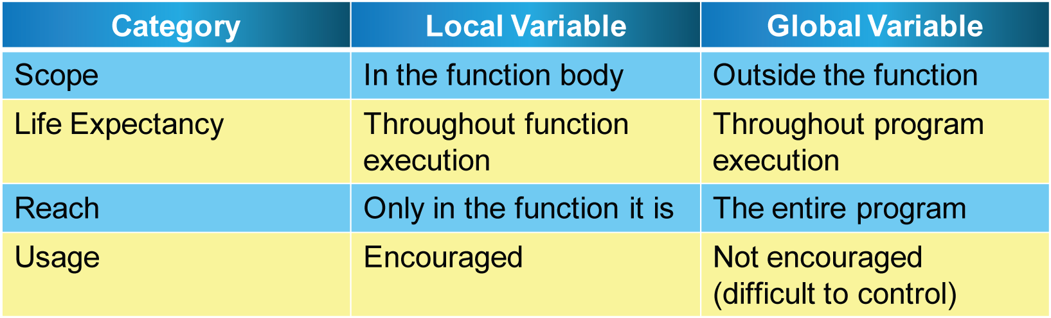
Variable Scope
Variable scope refers to an area where the program can reach it.
Notes:
1-13

Slide 12
Local Variable
#include <stdio.h>
int main()
{
int x, y; /*local variable*/
printf(“enter two numbers: ”);
scanf(“%d %d”, &x, &y);
}
Notes:
1-13

Slide 13
Global Variable
#include <stdio.h>
int x, y; /*global variable*/
int main()
{
printf(“enter two numbers: ”);
scanf(“%d %d”, &x, &y);
}
Notes:
1-13

Slide 14
Recursion
Recursion refers to a function that makes a series of calls to itself.
Example:
  int factorial(int n)
  {
  if(n==0)
  return 1;
  else
  return n * factorial(n-1);
  }
Notes:
1-13

